Slide 1


Recommendation of Top 10 regions for Promotions on Alcohol consumption in Russia
BTAA - TEAM 7
DEVILSBASE

Slide 2
TABLE OF CONTENTS
01
02
03
04
Introduction
Data Cleaning & EDA
Team and Project Overview
Mention key steps involved in data cleaning to visualization
Analysis Techniques
Conclusion
Outline the analytical methods and tools used to analyze the consumption data.
Introduce the concept of offer promotion as a potential solution

Slide 3





PROJECT TEAM - DEVILSBASE
Tanisha Kumar
Research Analyst
Linh Pham
Data Preprocessor
Anushka
Madiwale
Communicator
Adit Patel
Data Analyst
Balaji Raj Veluchamy
Project Lead and Co-ordinator + EDA

Slide 4
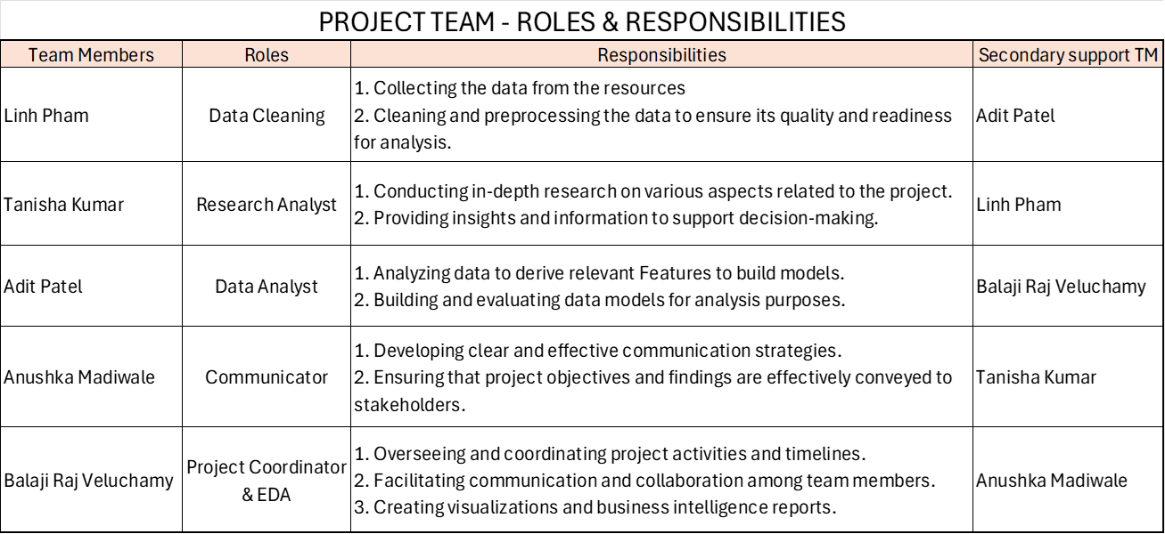
PROJECT TEAM - COORDINATION
01
COMMUNICATION
CLEANING
05
BDA
PROJECT COORDINATION
02
ANALYSIS
RESEARCH
04
03
VISUALIZATION

Slide 5
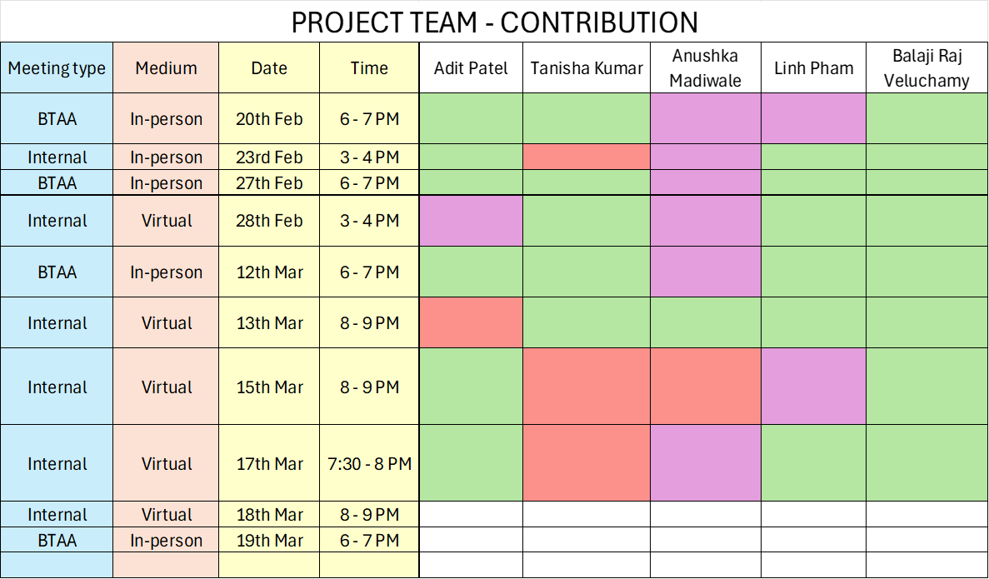
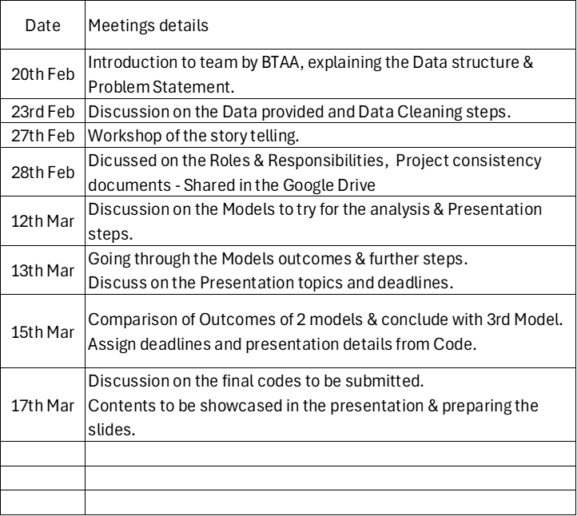
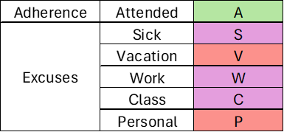
PROJECT TEAM - CONTRIBUTION

Slide 6
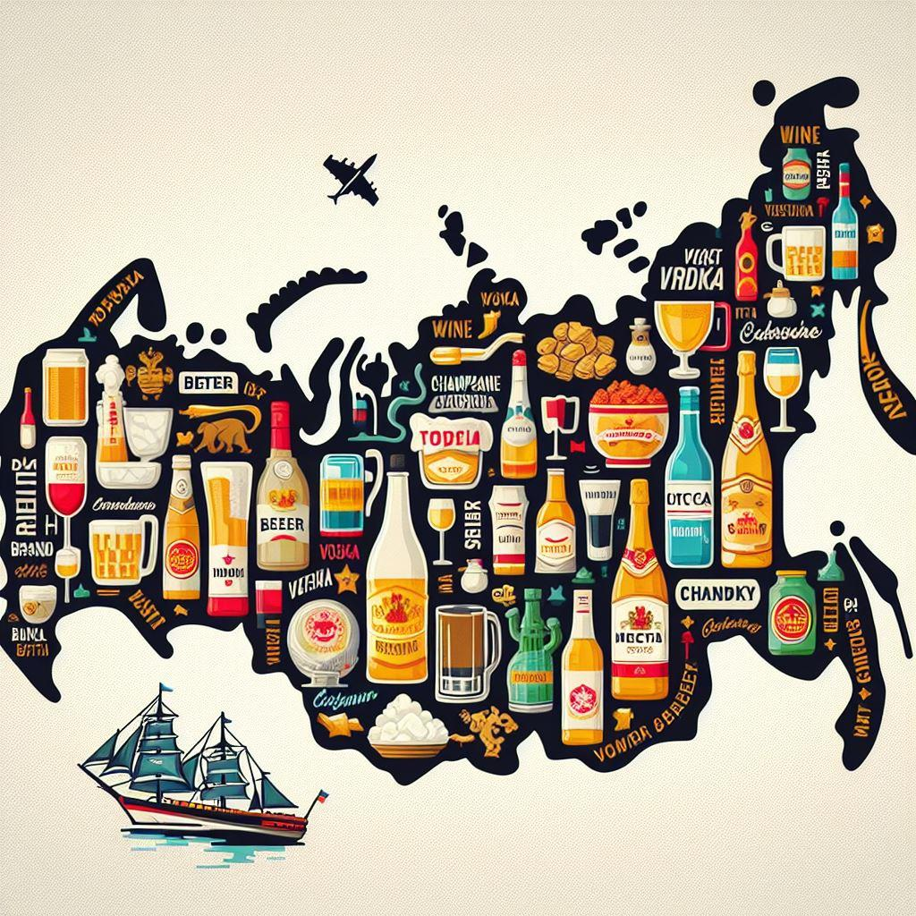
BUSINESS STATEMENT
Optimizing Promotional Strategies for Alcohol Consumption in Russia’s Regions
Identify 10 regions in Russia with similar buying habits to Saint Petersburg for an alcohol promotion, leveraging secondary research data from credible sources. The goal is to replicate the success of a Alcohols promotion in Saint Petersburg while optimizing costs and resources. Recommendations will be based on comprehensive analysis of historical sales data and consumer behavior patterns.
Image developed using Microsoft Copilot based on Russia map and Alcohols

Slide 7
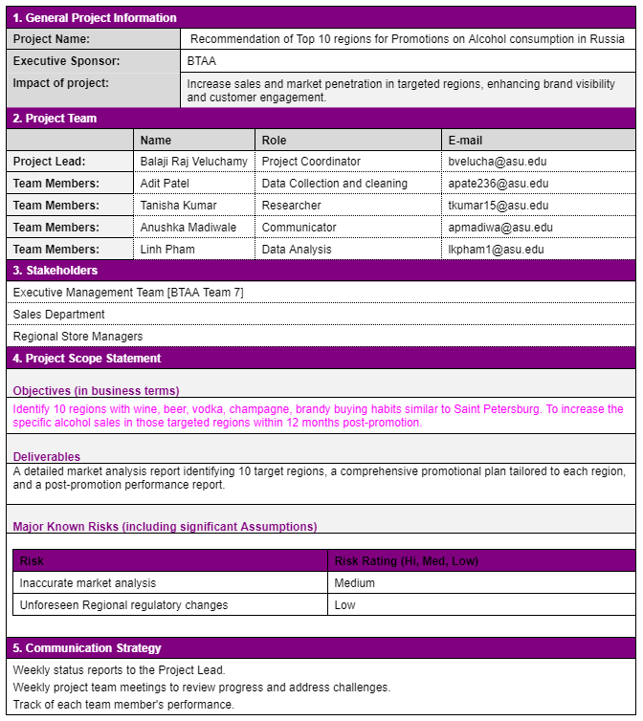
PROJECT
CHARTER
The project charter outlines the objectives, scope, team members, stakeholders, risks, and communication strategy for the initiative aimed at recommending top regions for alcohol promotions in Russia.

Slide 8
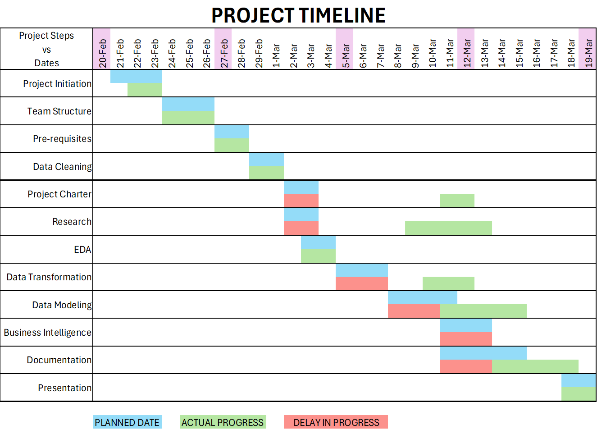
PROJECT PLAN vs ADHERENCE
Rigid structure for the Data Analysis project.
Adapting to adhere the Project plan w.r.t Team availability.

Slide 9
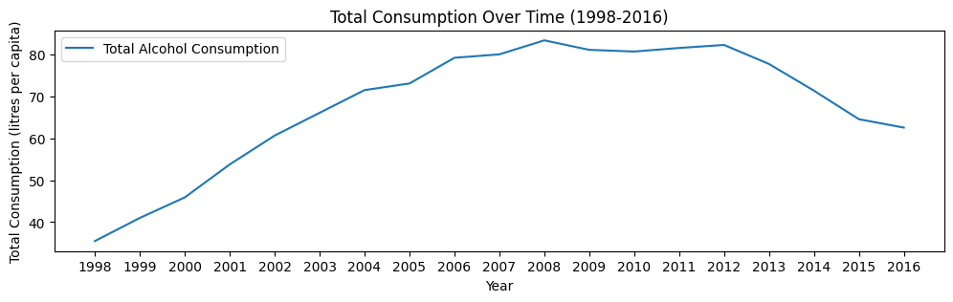
1615 samples of data.
7 Columns [Year, Region, Wine, Beer, Vodka, Champagne, Brandy]
DATA OVERVIEW
Alcohols are ‘per Capita’
( Litres of Alcohol consumed by Populations )
19 Years of data
85 Regions in Russia

Slide 10
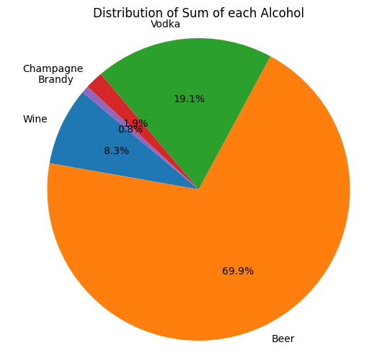
DATA OVERVIEW
Beer (69.9%) : The high consumption of beer may be influenced by its affordability, cultural acceptance, and availability in various social settings.
Vodka (19.1%) : Vodka's significant consumption could be attributed to its cultural significance, traditional use in social rituals, and versatility in mixed drinks and cocktails.
Champagne (1.9%) : The relatively low consumption of champagne suggests its association with special occasions and celebrations rather than everyday consumption habits.
Brandy (0.8%) : Brandy's modest consumption may be linked to its niche market appeal, perceived quality, and preference among connoisseurs and older demographics.
Wine (8.3%) : Wine's moderate consumption could be driven by its diverse varieties, cultural importance, and growing popularity among younger demographics for social occasions and culinary experiences.

Slide 11
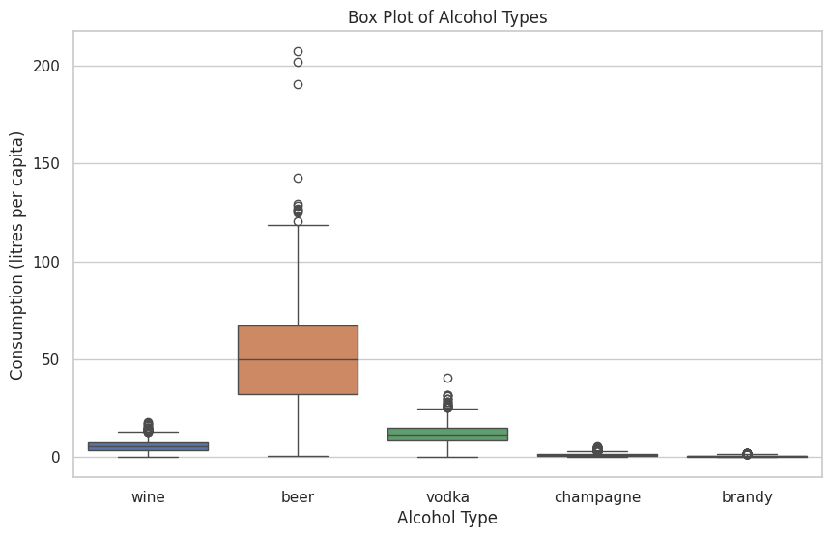
DATA OVERVIEW
Wine : Moderate wine consumption (5.63 liters per capita) may be influenced by perceived health benefits and cultural norms, while economic factors like affordability and marketing strategies play significant roles.
Beer : Beer's popularity (51.26 liters per capita) stems from its affordability, availability, and social acceptability, but excessive consumption poses health risks and contributes significantly to employment and tax revenues.
Vodka : Vodka's cultural significance and affordability drive its consumption (11.82 liters per capita), despite health risks such as addiction and liver damage. Economically, vodka production contributes to government revenues but also imposes healthcare costs.
Champagne : Champagne consumption (1.31 liters per capita) is limited, reserved for special occasions, with minimal health risks but significant economic contributions to luxury markets and tourism.
Brandy : Brandy's consumption (0.53 liters per capita) is niche, influenced by price and market appeal, offering modest health benefits but contributing to diversity in the spirits industry and catering to premium consumer segments.

Slide 12
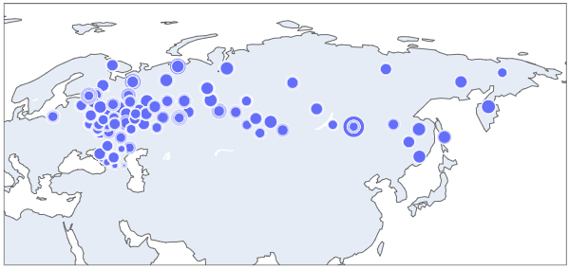
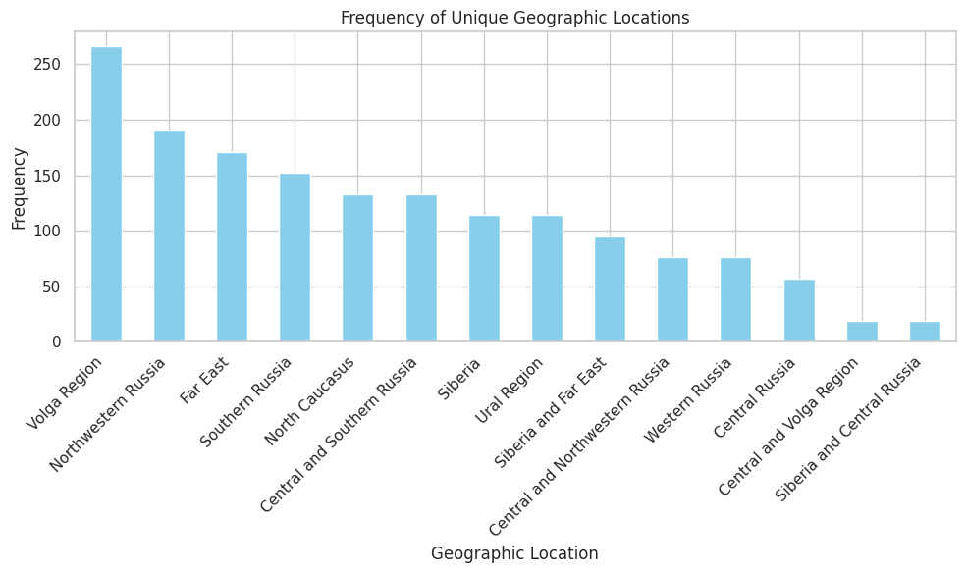
Resources from Research
Using the Lat to Long data
We have undertaken efforts to enhance the dataset by incorporating additional resources from Research.
Latitude and longitude coordinates from Data Library.
Geographical location names from external research materials.
By enriching the dataset with this supplementary data, we aim to provide a more comprehensive and insightful analysis of alcohol consumption patterns across different regions in Russia.
Using the Geolocation research.
We have 14 locations

Slide 13
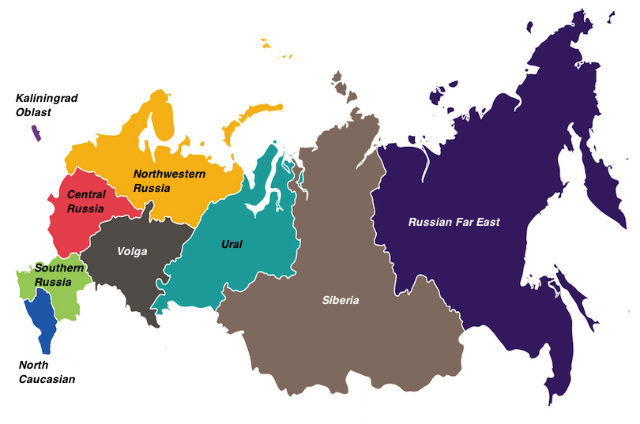
Geo Locations Research
Volga Region : The Volga Region boasts a diverse cultural heritage and fertile lands, contributing significantly to Russia's agricultural and economic prosperity.
Northwestern Russia : Northwestern Russia is renowned for its stunning natural beauty, vibrant cities, and rich cultural heritage, attracting visitors from around the world.
Far East : The Far East region of Russia is characterized by its breathtaking landscapes, diverse wildlife, and strategic importance in international affairs.
Southern Russia : Southern Russia offers a blend of climates, picturesque coastlines, and cultural diversity, making it a vibrant and dynamic region.
North Caucasus : The North Caucasus region is known for its rugged mountains, rich cultural heritage, and strategic significance in Eurasian geopolitics.
Central and Southern Russia : Central and Southern Russia are the country's agricultural heartland and economic powerhouse, featuring vast territories with diverse landscapes and cultural heritage.
Siberia : Siberia is synonymous with vast wilderness, extreme climates, and abundant natural resources, playing a crucial role in Russia's economic development.
Ural Region : The Ural Region serves as a bridge between Europe and Asia, renowned for its mineral wealth, industrial centers, and unique cultural heritage.
Western Russia : Western Russia is a vibrant and diverse region, featuring bustling cities, historic towns, and picturesque countryside that reflects its rich cultural heritage.
Central Russia : Central Russia is the heartland of the country, characterized by historic cities, fertile plains, and cultural landmarks that embody Russia's rich heritage.
Central and Volga Region : The Central and Volga Region is known for its historic cities, picturesque landscapes, and economic significance as a hub of trade and commerce.
Siberia and Central Russia : Siberia and Central Russia encompass vast territories with diverse landscapes, abundant natural resources, and unique cultural heritage.
Far East and Siberia : The Far East and Siberia regions are renowned for their pristine wilderness, unique ecosystems, and strategic importance in Russia's economic development.
Central and Northwestern Russia : Central and Northwestern Russia feature a blend of historic cities, picturesque countryside, and cultural landmarks, reflecting Russia's rich heritage and diverse landscapes.

Slide 14

02
Data Cleaning

Slide 15
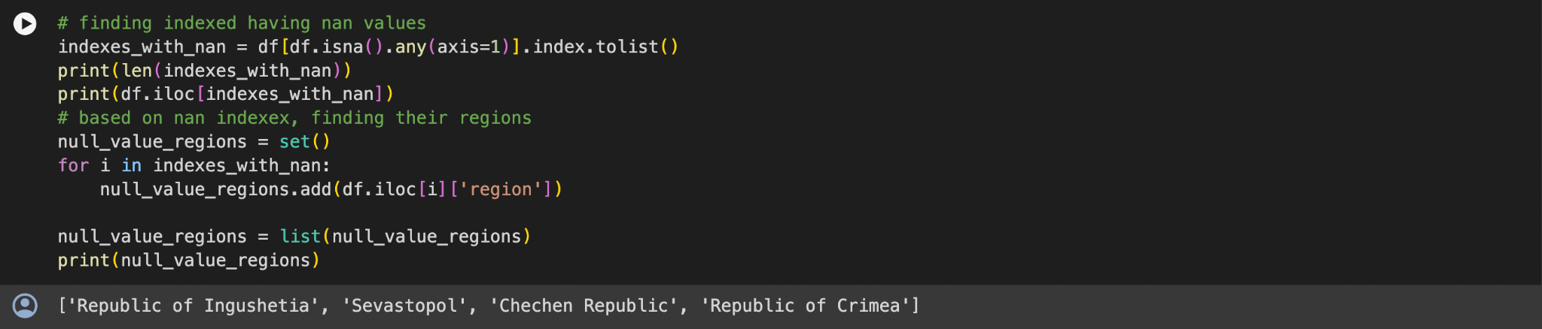
DATA PREPROCESSING
From the Dataset given, we could find the bunch of missing values.
Analyzed the missing values whether to remove or replace.
We finally eliminated all the NaN values to their relevant regions. (Below 4 Regions)
Reduced from 85 regions to 81 regions.

Slide 16

02
Exploratory Data Analysis

Slide 17
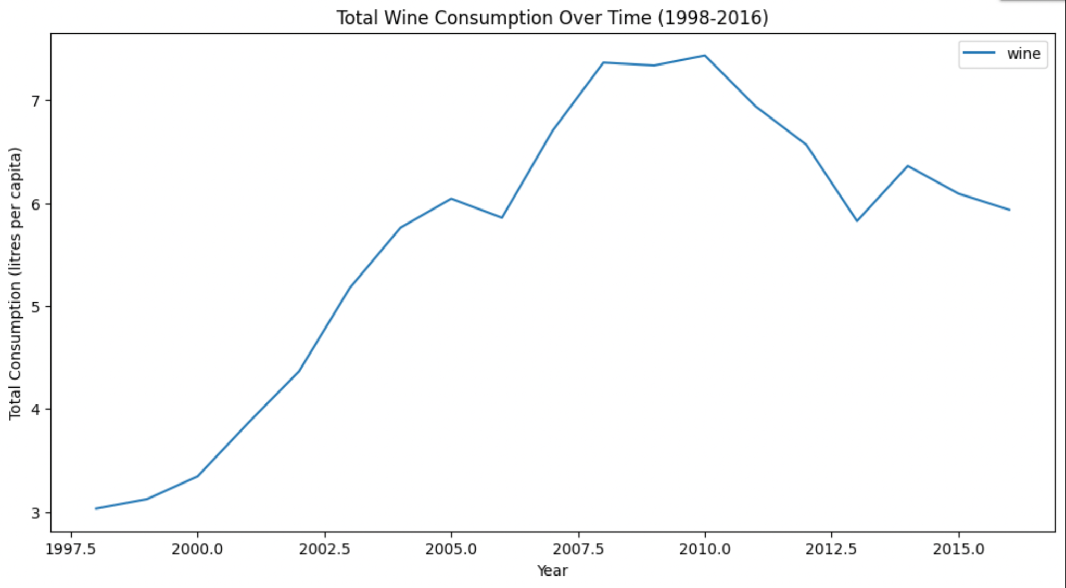
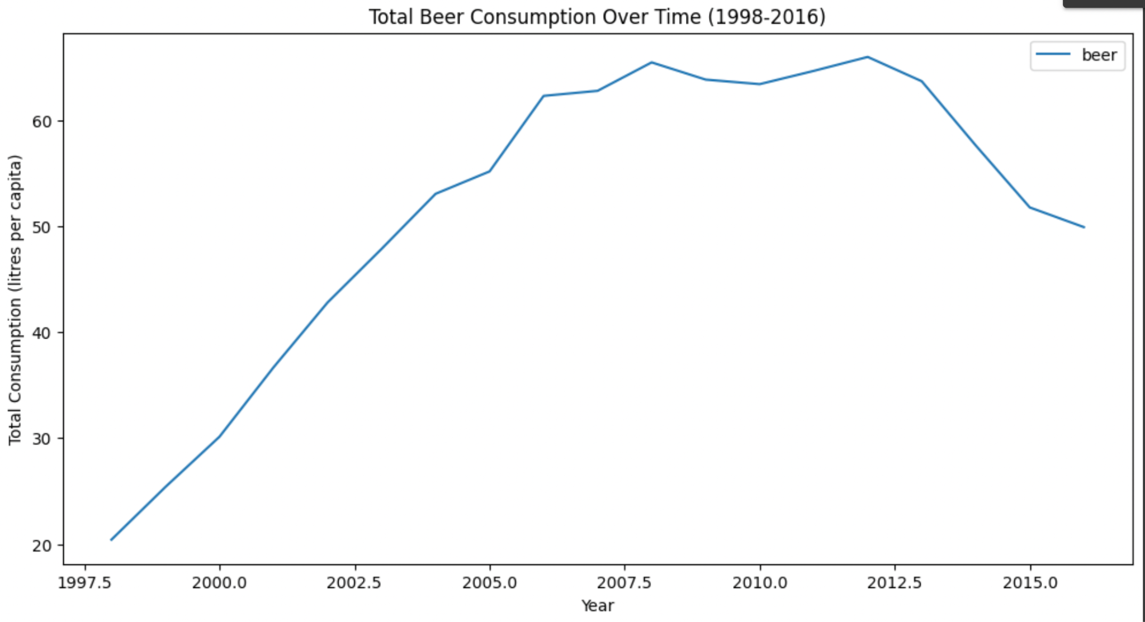
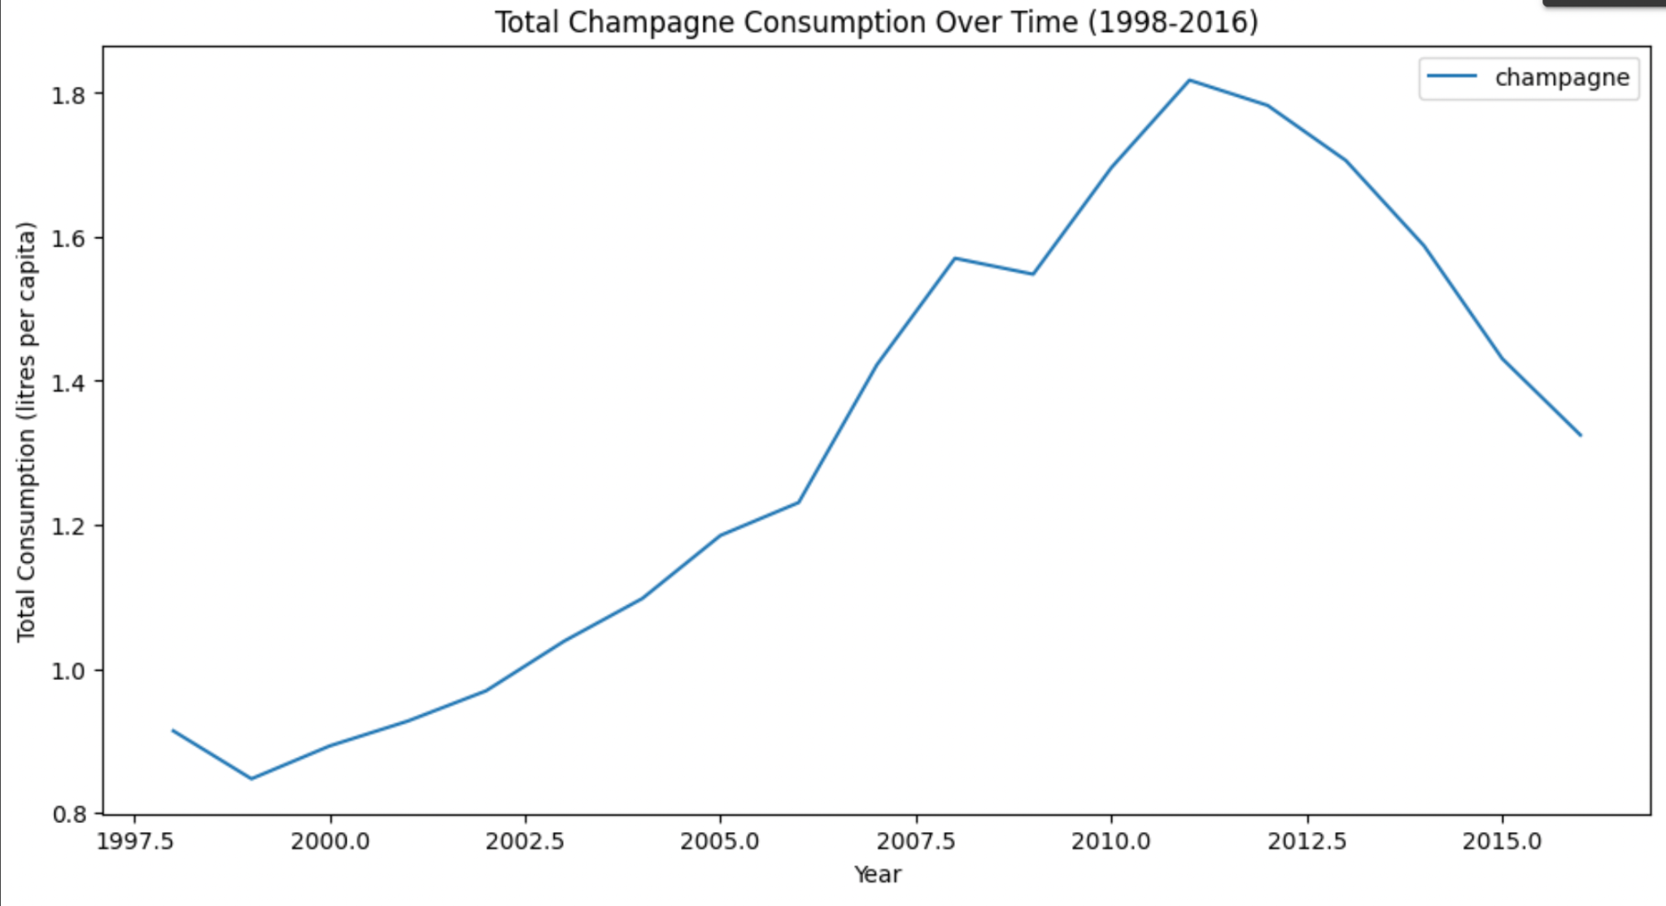
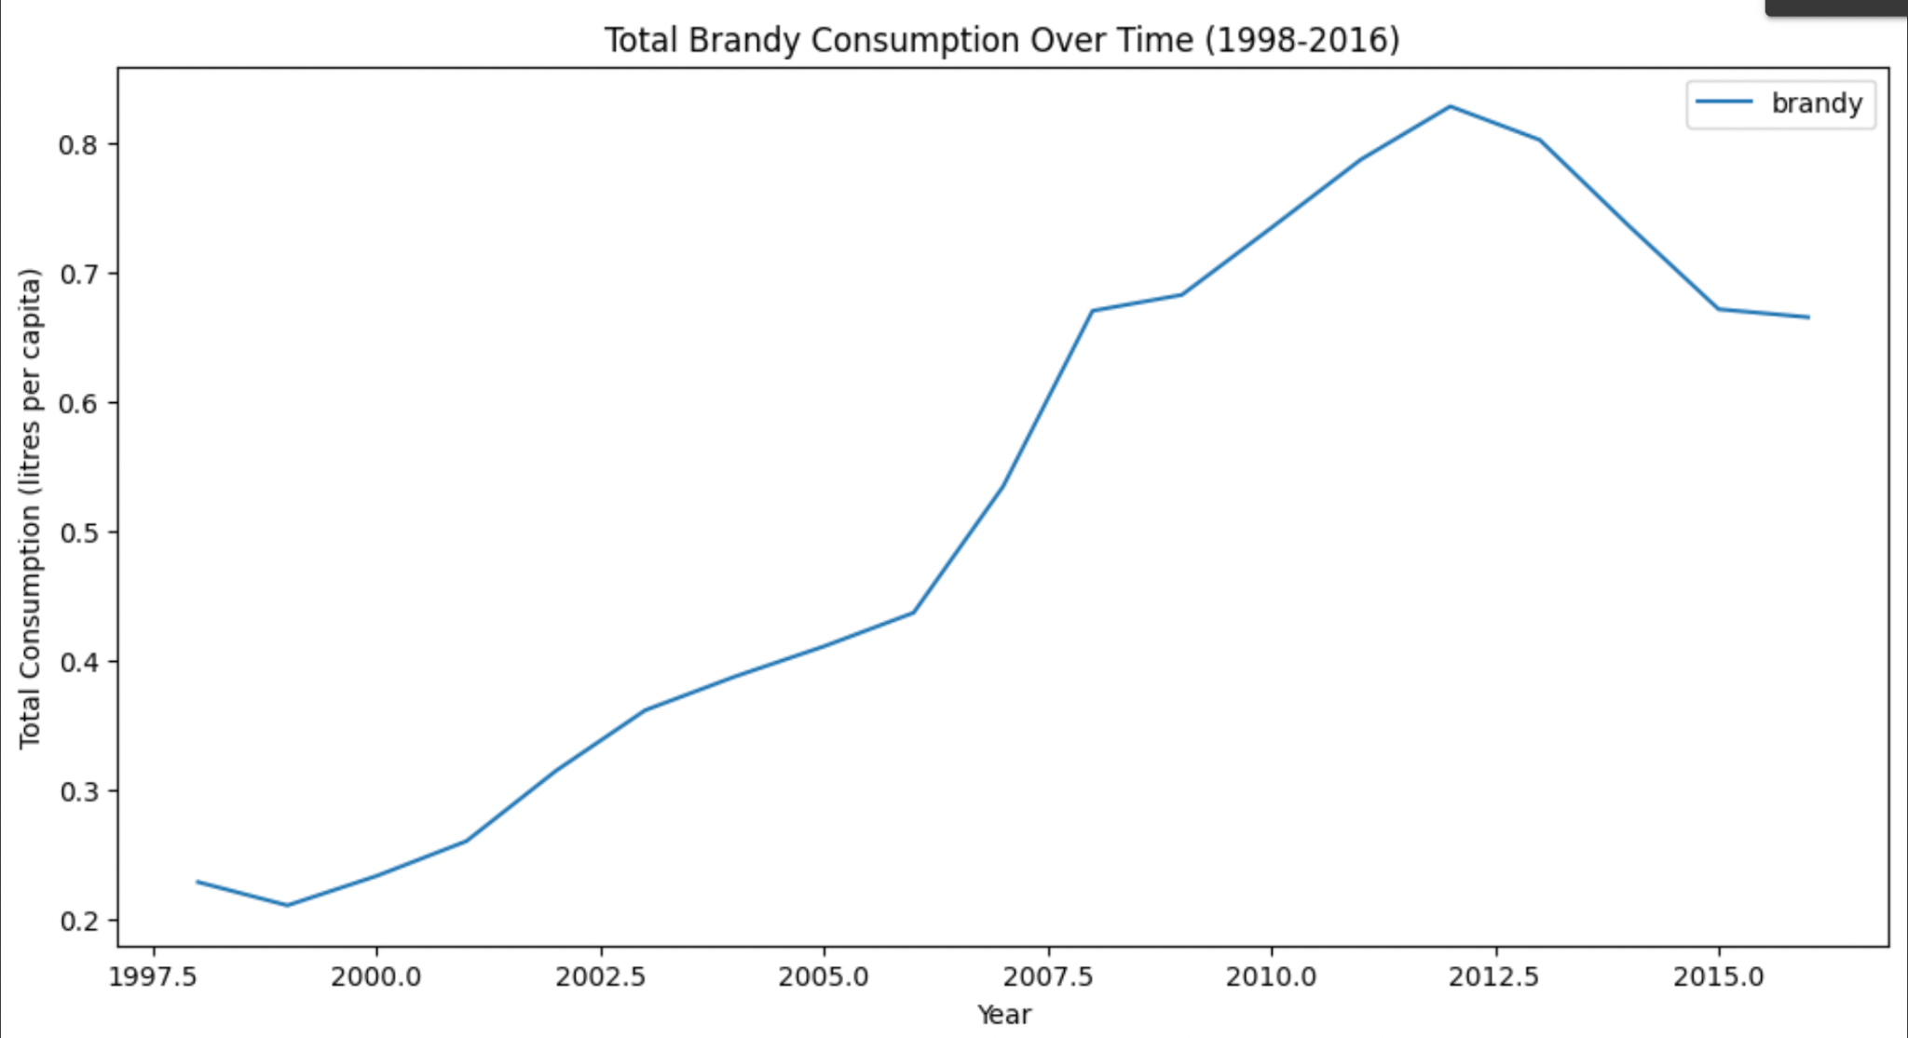
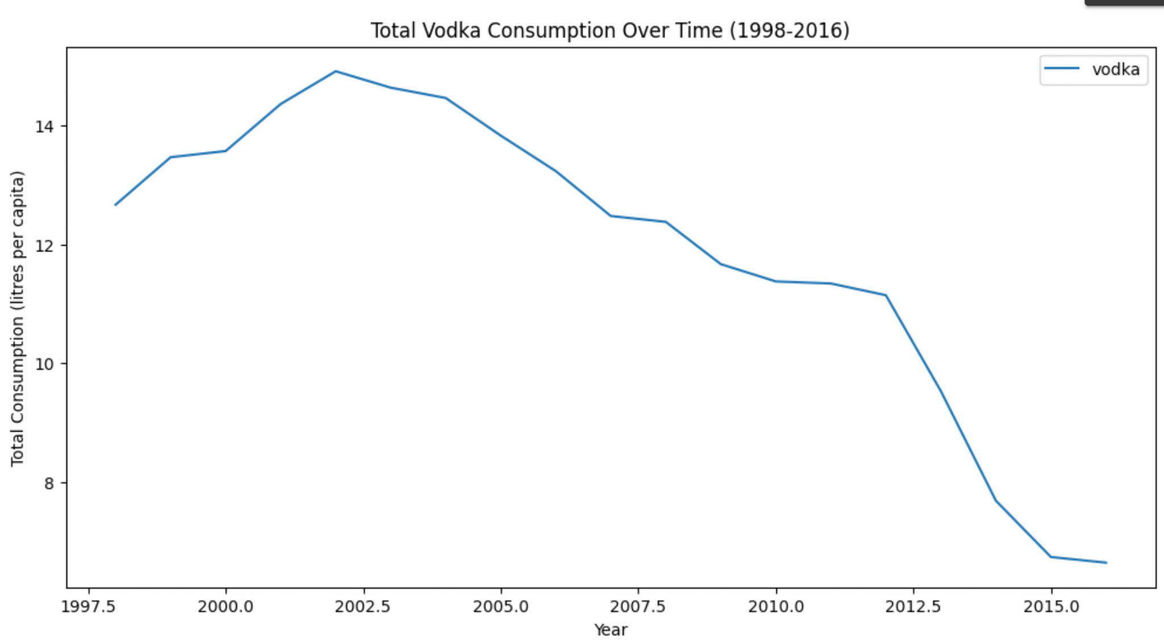
Time - Series Plot
Reached the bottom in 2015

Slide 18
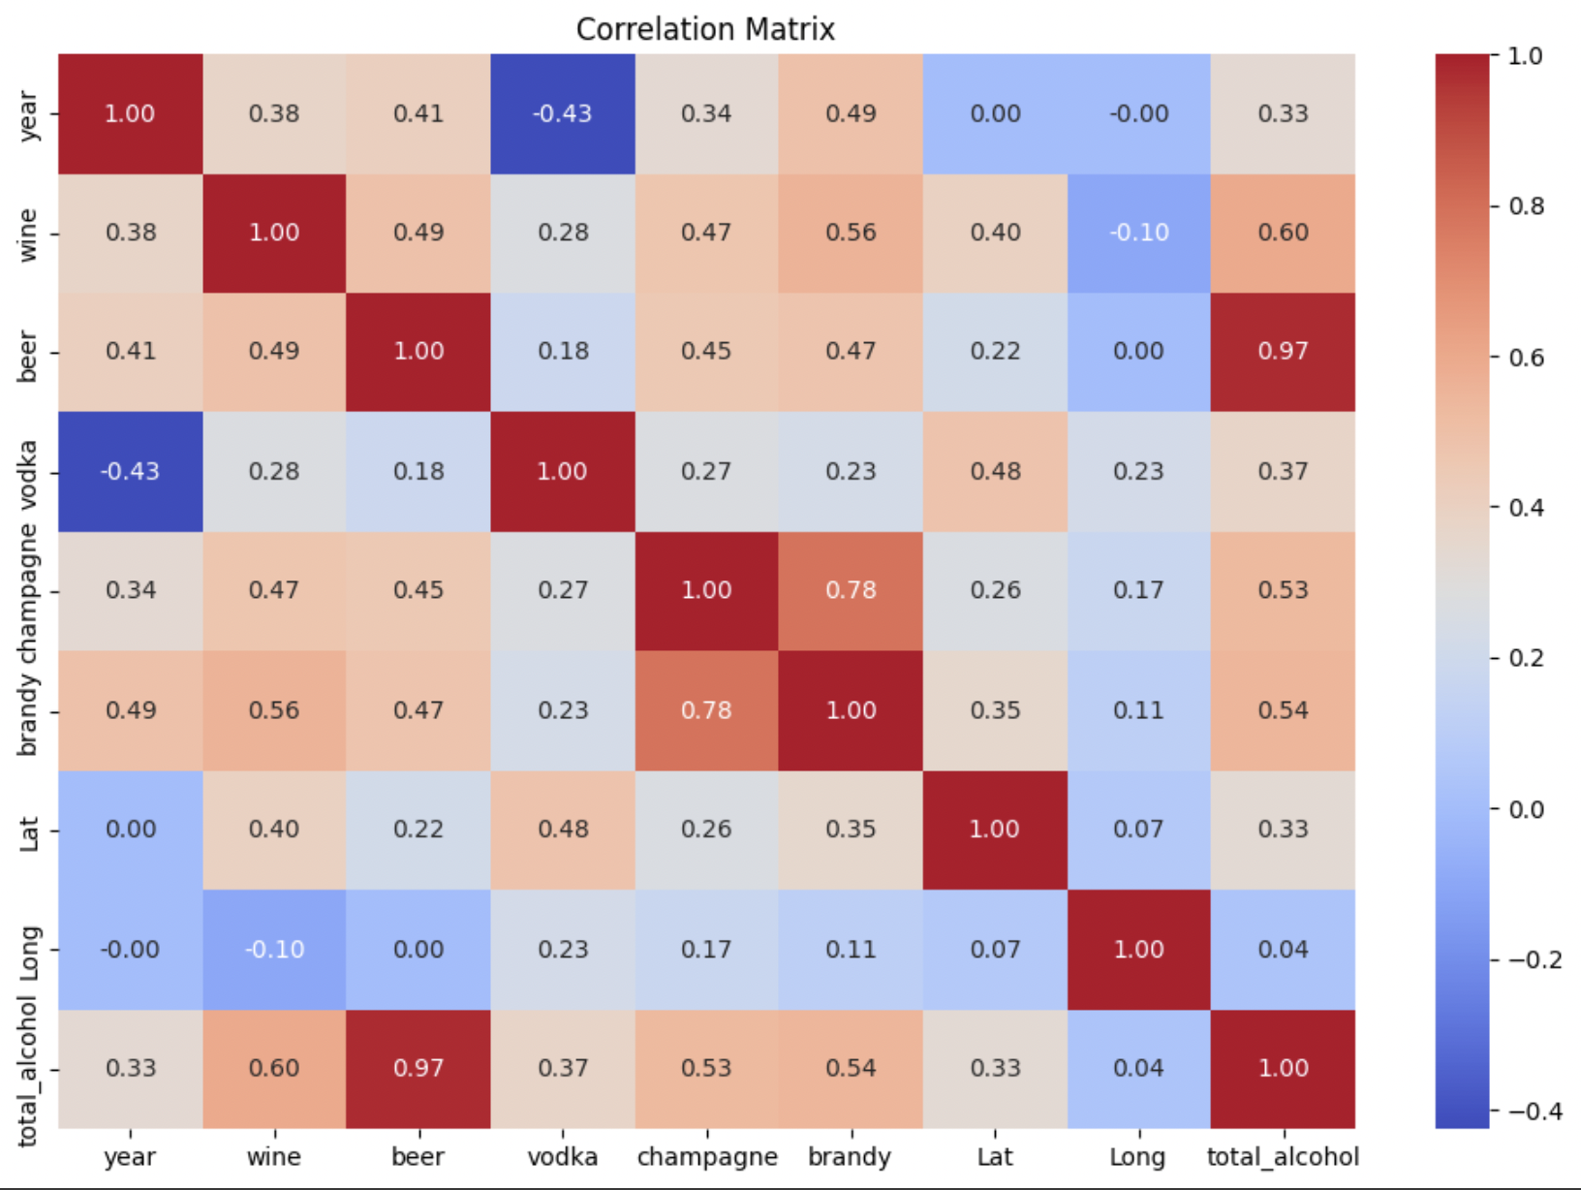
Correlation Matrix
The correlation between champagne and brandy surprisingly high (0.78)
The increase in champagne consumption is more likely lead to the increase in brandy

Slide 19
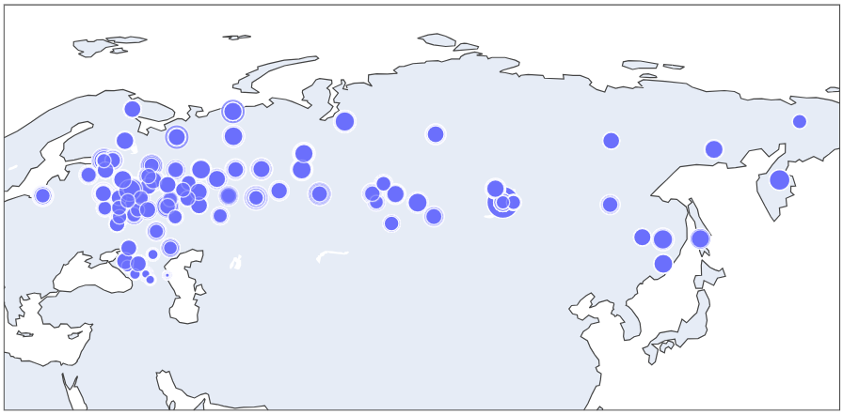
Geographical Analysis
Saint Petersburg
Most of the locations are marked at the Volga, Northwestern, Central and Ural Regions of the Russia.

Slide 20

03
Analysis Method
– Hierarchical Clustering
Cosine Similarity
Collaborative Filtering

Slide 21
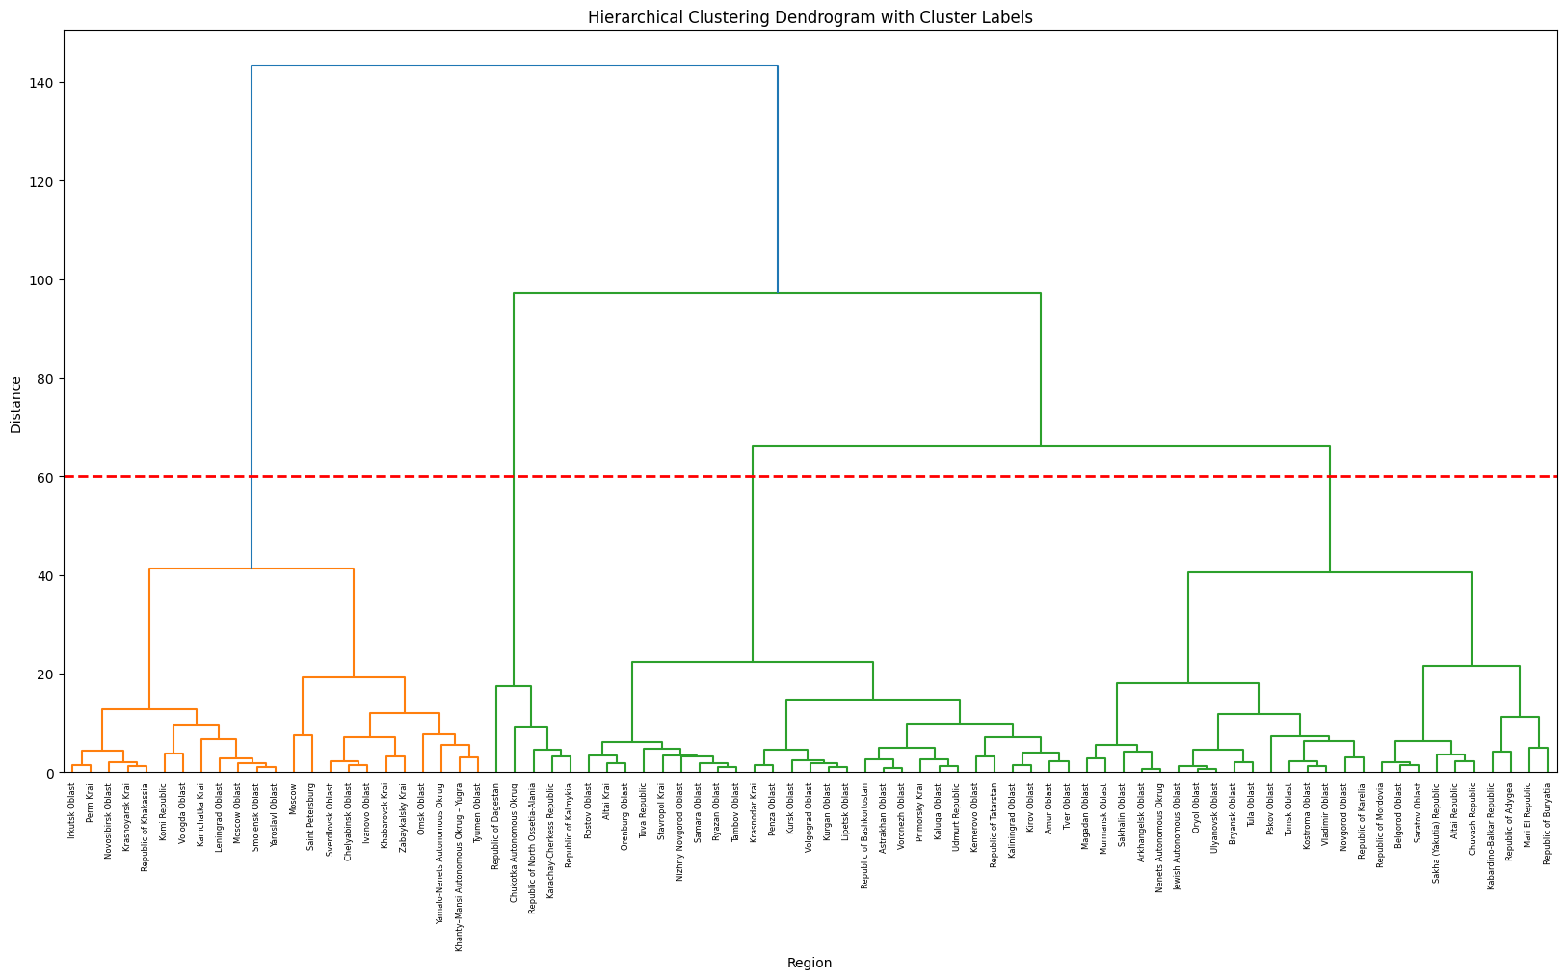
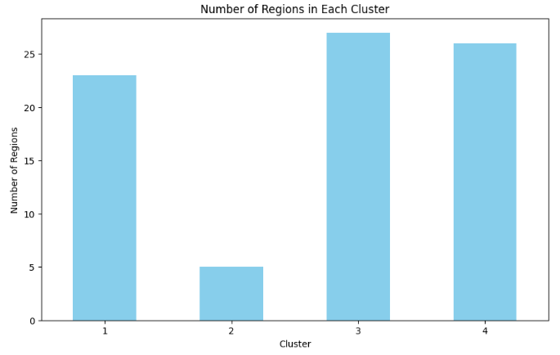
Analytical Method - Hierarchical Cluster
There are totally four clusters from the Dendrogram.
Saint Petersburg is linked with the Cluster 1.
Eliminating other clusters to avoid overprocessing.

Slide 22
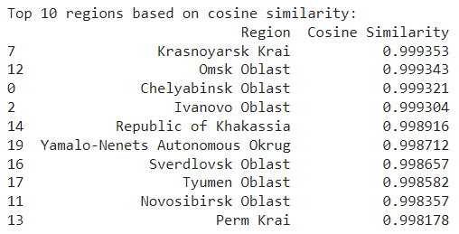
Cosine Similarity :
Cosine similarity quantifies the similarity between two vectors by measuring the cosine of the angle between them. It ranges from -1 to 1, where 1 indicates perfect similarity, 0 indicates no similarity, and -1 indicates perfect dissimilarity.

Slide 23
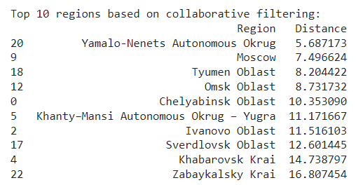
Collaborative Filtering
Collaborative filtering leverages collective preferences for personalized recommendations. Euclidean distance measures dissimilarity between regions, aiding in identifying similar ones.

Slide 24
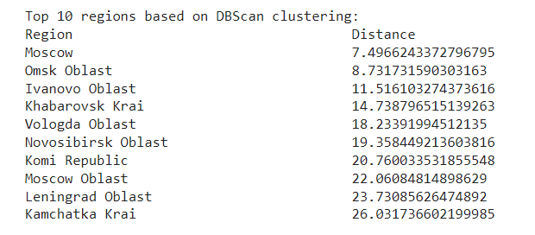
DBSCAN Clustering
DBSCAN can be a valuable tool in the collaborative filtering process by efficiently identifying clusters of users or items with similar preferences, handling sparse data, and improving the quality of personalized recommendations.

Slide 25

04
Conclusion

Slide 26
Resources from Research
General Trend
Population Decline: Many regions, especially in the more remote or economically challenged areas, have seen population declines. This is often due to out migration towards more economically prosperous regions, lower birth rates, and higher death rates.
Population Growth: Regions with stronger economies, particularly those benefiting from natural resources (oil, gas, minerals) or significant industrial and technological development, have often seen population growth. This includes areas that have attracted internal migration for employment opportunities.
Stabilization: Some regions have experienced periods of population stabilization due to a balance of birth and death rates, or successful efforts to attract or retain inhabitants through regional development programs.

Slide 27
Resources from Research
North Caucasus (e.g., Karachay-Cherkess Republic, Kabardino-Balkar Republic, Republic of North Ossetia-Alania, Republic of Dagestan): Generally, these regions have significant Muslim populations where alcohol consumption might be lower due to religious and cultural practices.
Siberia and Far East (e.g., Krasnoyarsk Krai, Irkutsk Oblast, Primorsky Krai, Chukotka Autonomous Okrug): Harsh climates and isolation can contribute to higher alcohol consumption rates, a trend noted in various studies. Efforts to combat alcoholism in these regions are crucial for public health.
Volga Region (e.g., Republic of Bashkortostan, Chuvash Republic): The diversity of the Volga region, with a mix of ethnicities and religions, means alcohol consumption rates can vary widely. Predominantly Muslim republics might see lower consumption rates.
Central and Southern Russia (e.g., Kaluga Oblast, Lipetsk Oblast, Voronezh Oblast): These areas, with their mix of urban and rural populations, might see varied consumption patterns, potentially correlating with economic conditions and available social services.

Slide 28
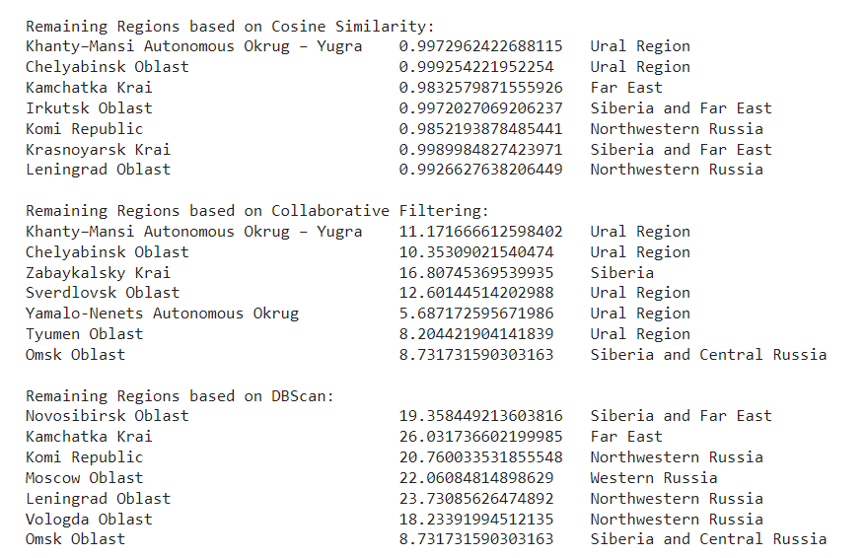
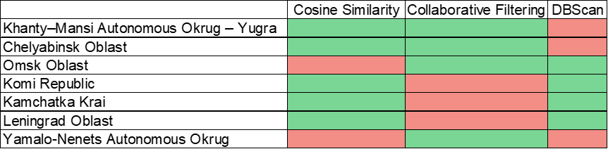
Final Recommendation
From the Cosine, Collaborative and DBScan values, we have confirmed 3 regions in common :
Moscow
Khabarovsk Krai
Ivanovo Oblast
Prior to the Research on the Geographical locations and values from the analysis.
We have confirmed remaining 7 regions.
Notes:
Good cosine val for 9 and 10. 1-6 are common in cosine and collabatrive

Slide 29
Thank You
ANY QUESTIONS ?

